Slide 1
PIPELINE BLOCKAGE DETECTION SYSTEM
Guided By :
PRESENTED By :
Gobika . I (22AI015)
Kanishgaa . A (22AI019)
Narmatha . M (22AI029)
TEAM NO : 13
22AIC14 : Internet of Things & It’s Application

Slide 2
Abstract
This project presents an IoT-based system for real-time detection and monitoring of blockages in pipelines.
By integrating IoT sensors, the system can automatically identify potential blockages and other anomalies.
Data collected from sensors is transmitted to website through wifi, allowing continuous monitoring from any location.
This significantly improves operational efficiency and reducing repair costs by addressing issues before they escalate.

Slide 3
Objectives:
To develop a system capable of continuously monitoring pipelines and detecting blockages in real-time using IoT sensors.
To reduce pipeline downtime by enabling active maintenance and automated blockage alerts
To reduce maintenance costs by preventing severe pipeline damage through timely detection of potential blockages
To provide a website for monitoring and control, allowing to access pipeline data and respond to issues from any location.

Slide 4
Components Required:
Flow rate sensor
8085 Microprocessor
32k RAM
32k ROM
NOT Gate
Decoder
LCD Display
ESP
Crystal
Latch
Powered by USB

Slide 5
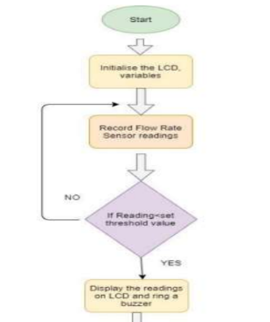
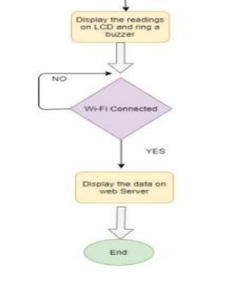
Flow Diagram:

Slide 6
Implementation: Both hardware & software
HARDWARE :
SOFTWARE :
Physical sensors are installed in the pipeline to monitor conditions like flow rate and potential blockages.
Hardware components transmit data from the sensors to the website.
Develop the code for the 8085 microprocessor to read data from flow rate sensor and control output.
Program the ESP module to establish a Wi-Fi connection and send sensor data to a website for monitoring.

Slide 7
THANK YOU

